Slide 1

Study Unit 2
Department of Computer Science
Subject Code: COS1501
Theoretical Computer Science
Primary Lecturer:
Mr. Thapelo Sindane
Dr. Petra Le Roux

Slide 2
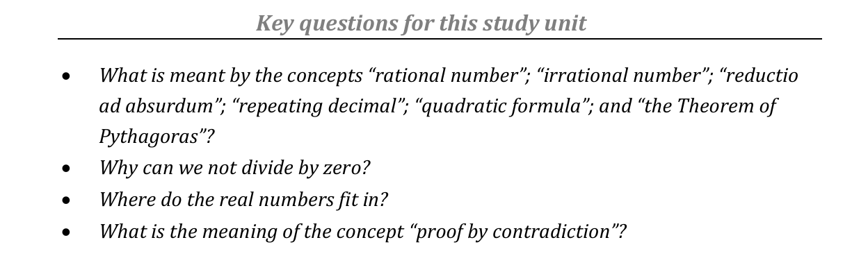
Study unit 2 Rational and real numbers: and

Slide 3


Study unit 2 Rational and real numbers: and
Rational numbers
Irrational numbers
Real numbers
Complex number ℂ

Slide 4
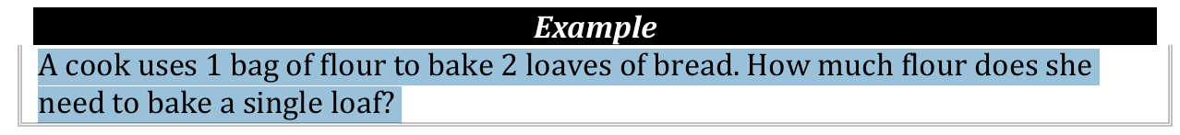
Context
How would you solve the following problem given the discussed number sets positive integers, non-negative integers, and integers ?

Slide 5
Solution
We therefore have to expand ℤ by including new numbers. We want all numbers of the form p/q, where you should regard the notation p/q as an abbreviation for the number by which q must be multiplied to give p.

Slide 6
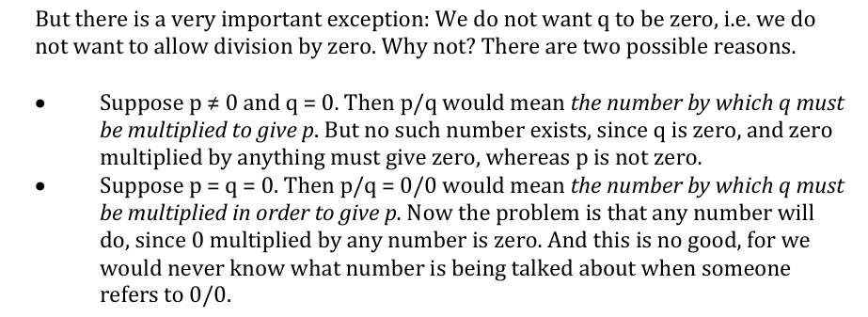
Exception

Slide 7
Exception

Slide 8
Issues
A famous mathematician called De Morgan, who lived nearly two centuries ago, showed some of the disastrous things that would happen if we tried to make it possible to divide by zero.

Slide 9
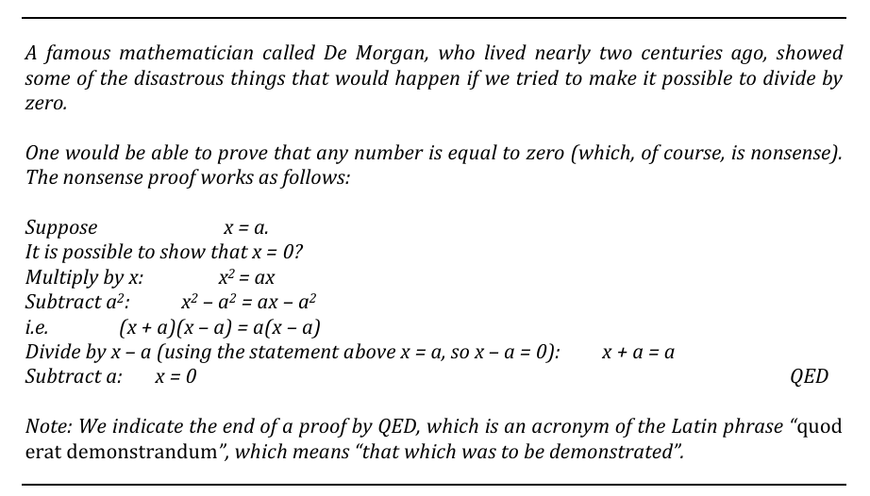
Proof

Slide 10
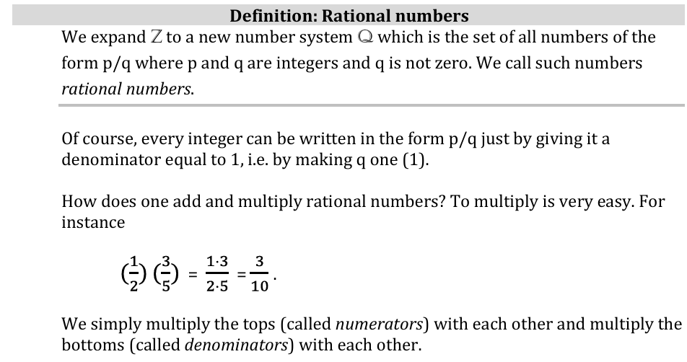
Formalism

Slide 11

Multiplication Rule

Slide 12
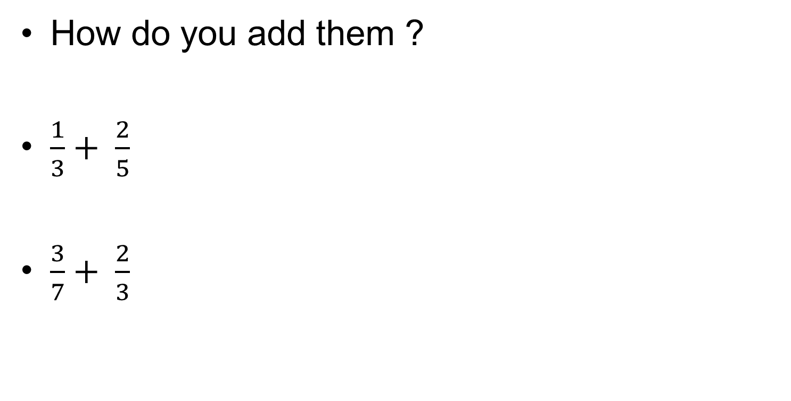
Formalism

Slide 13
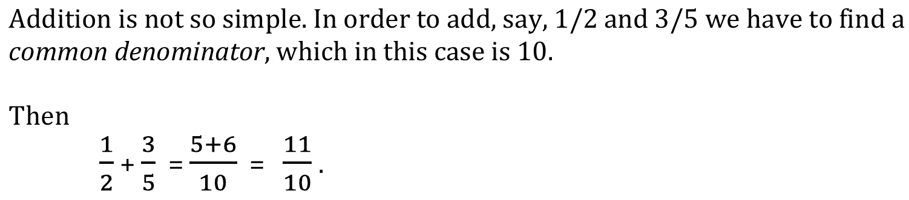
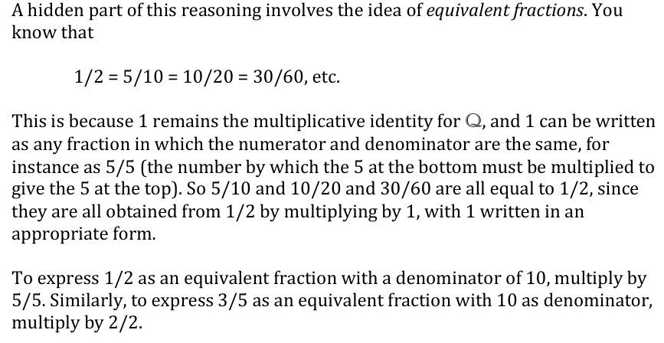
Addition Formalism

Slide 14
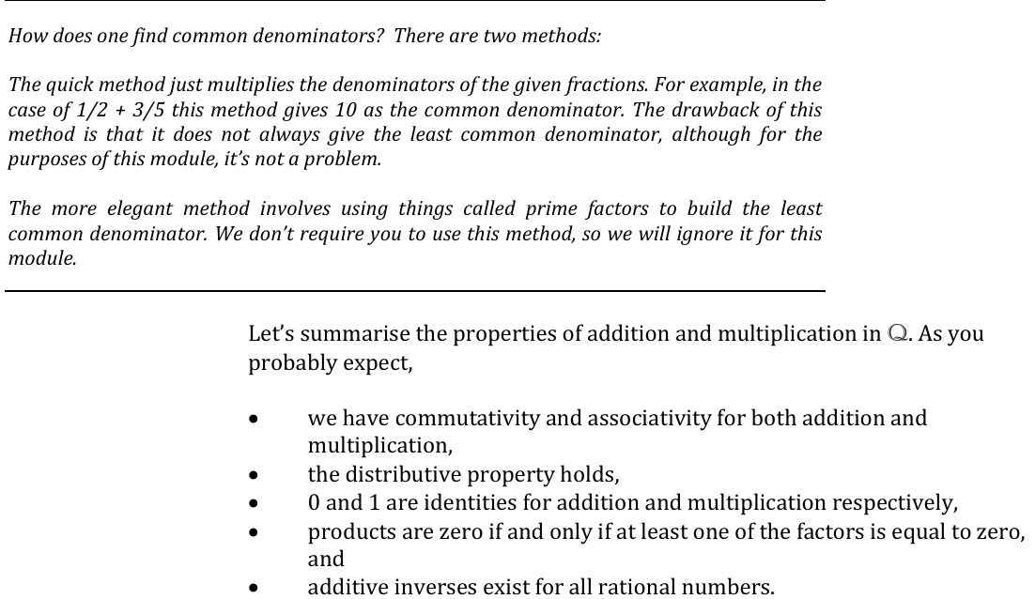
Recap

Slide 15
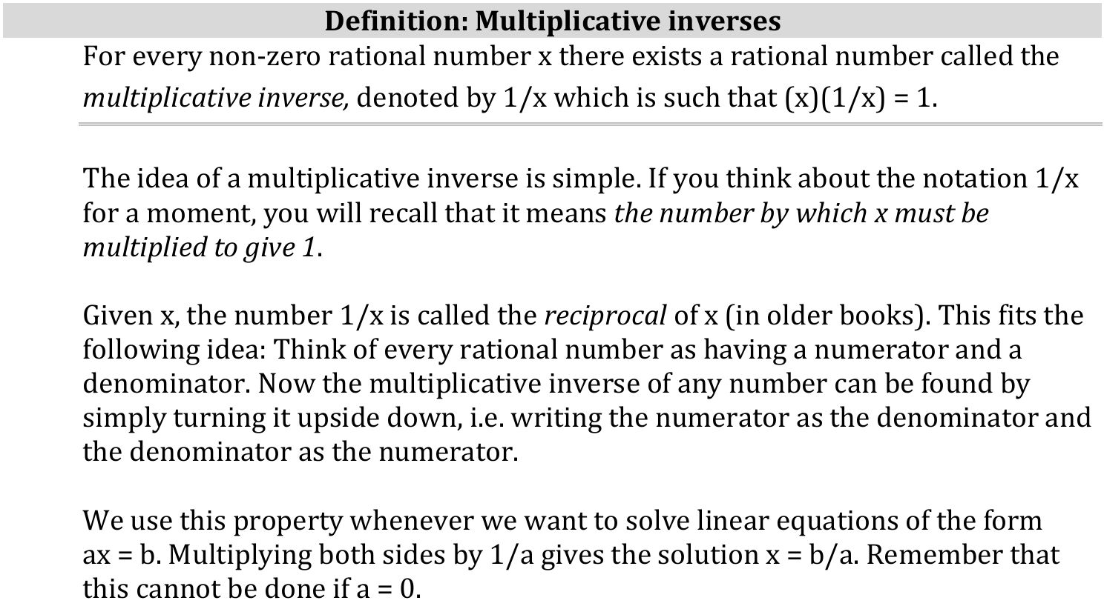
Definition: Multiplicative Inverse

Slide 16
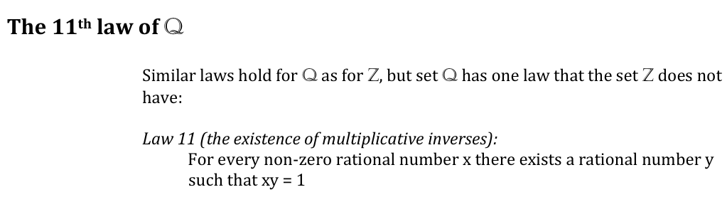
11th Law

Slide 17
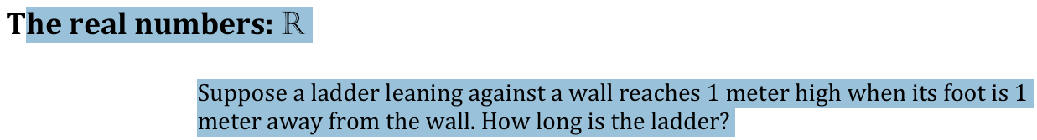
Real Numbers: Context First
How would you find its height?

Slide 18
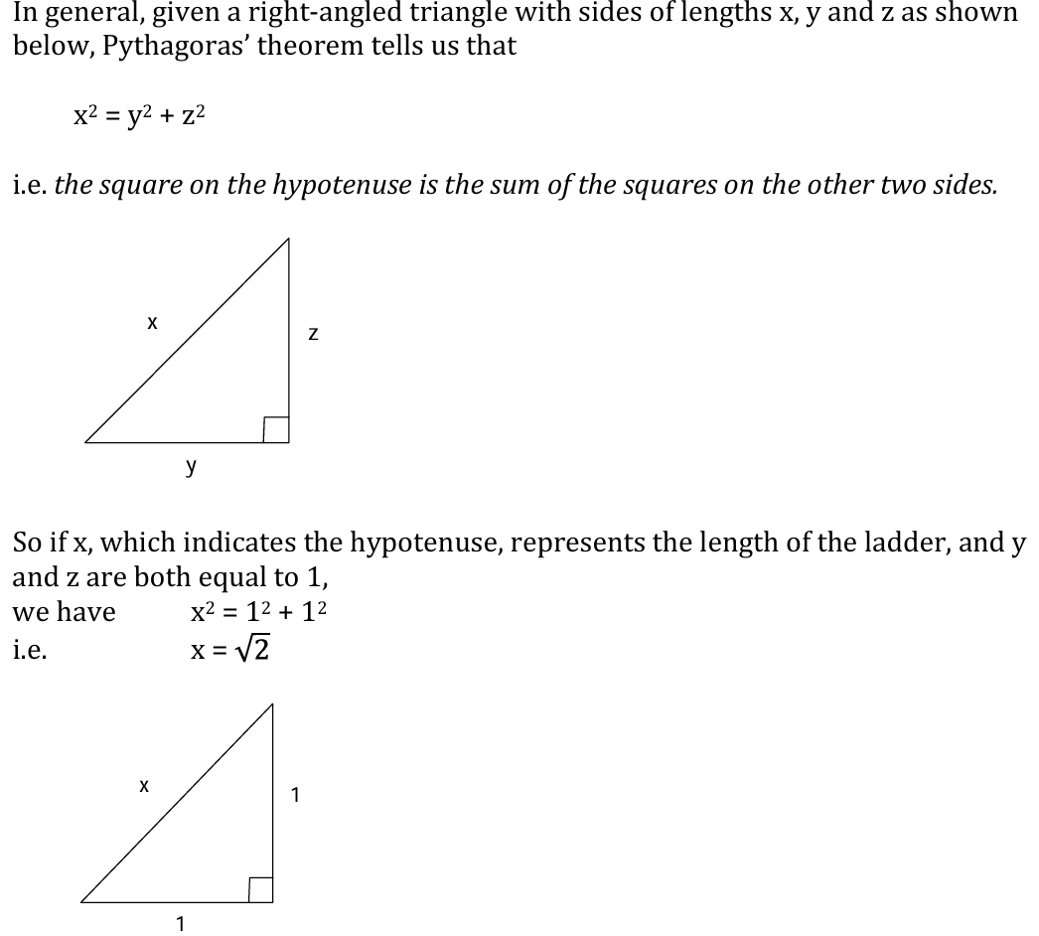
Theorem of Pythagorus

Slide 19
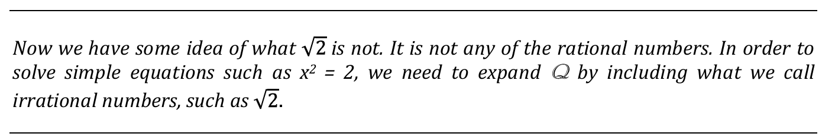
Need to expand

Slide 20
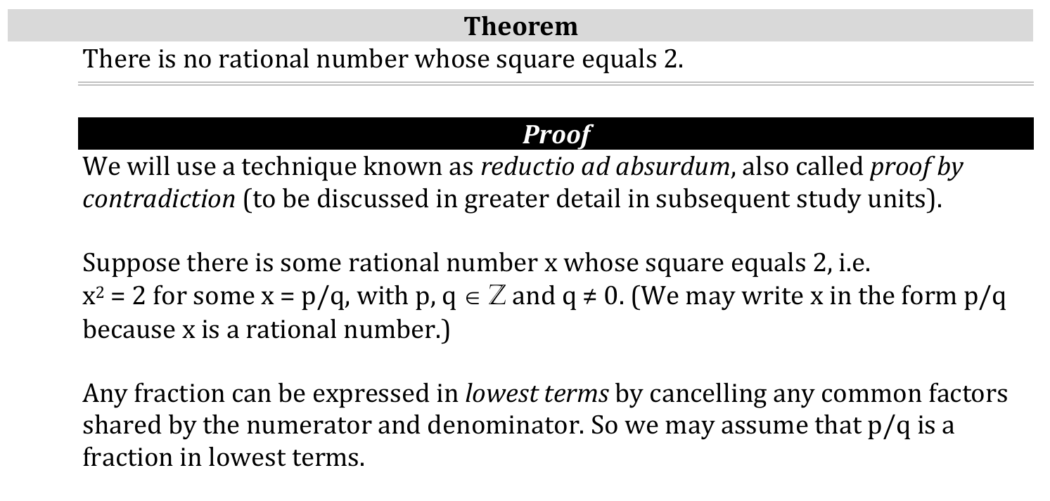
Proof

Slide 21
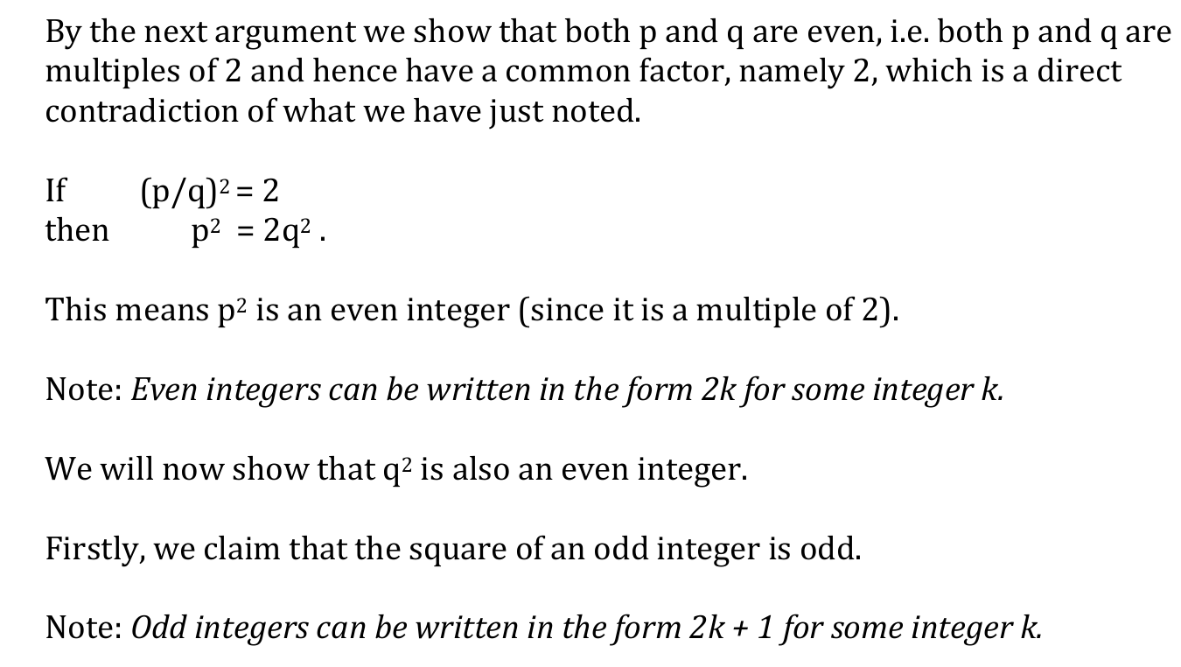
Proof

Slide 22
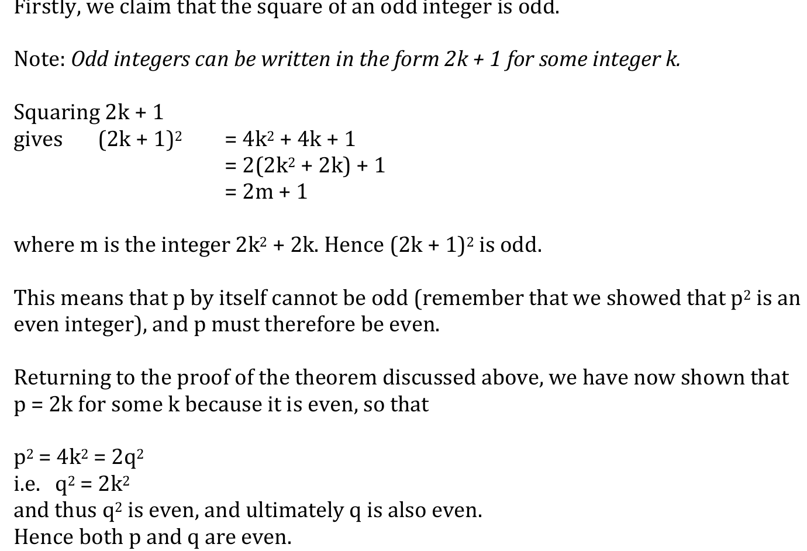
Proof

Slide 23
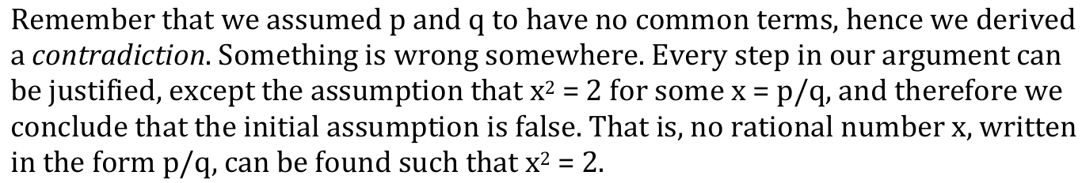
Proof

Slide 24
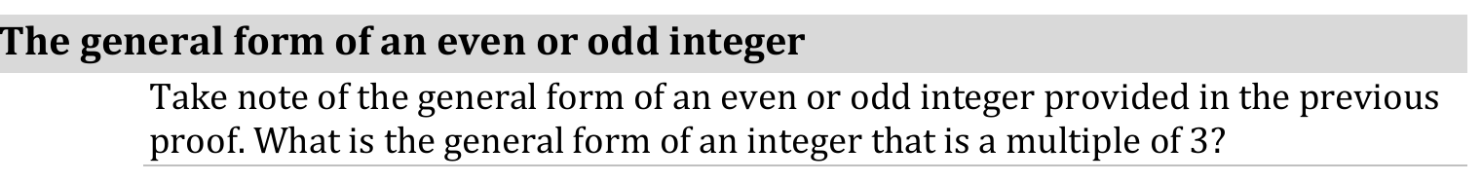
Recap

Slide 25
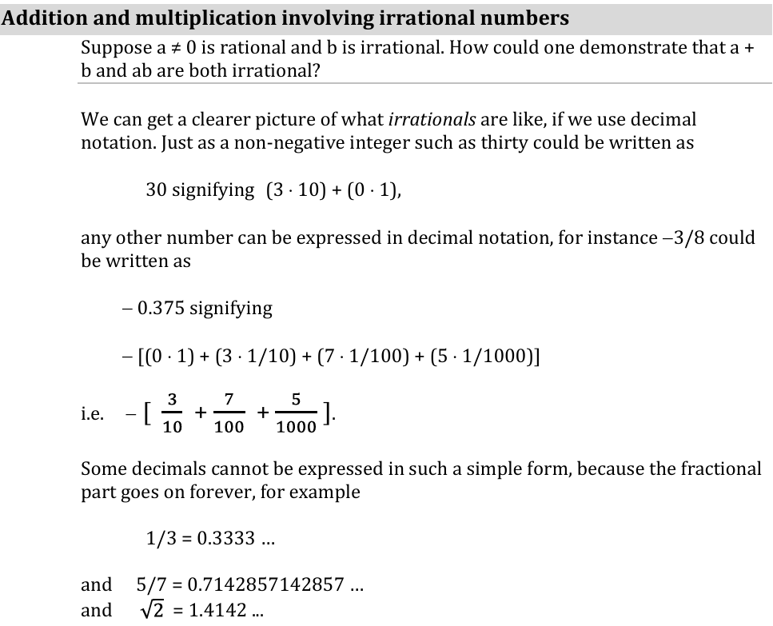
Addition and Mul. Involving irrational Num

Slide 26
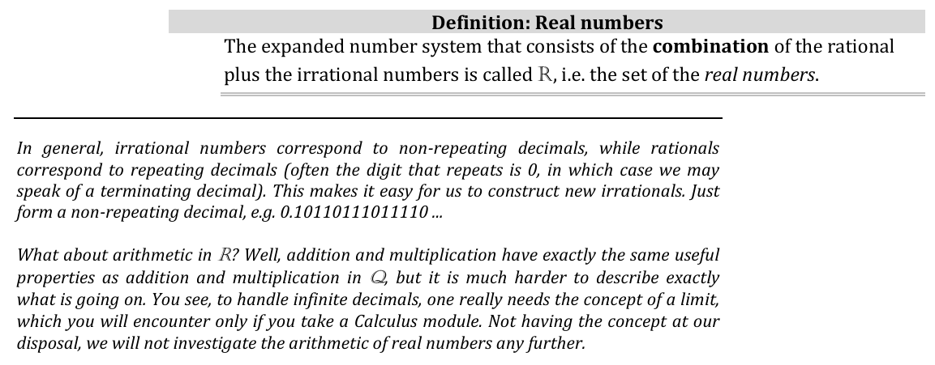
Introduction to Real

Slide 27
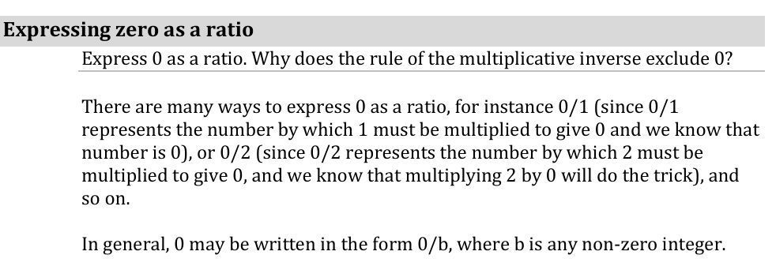
Expressing zero as a Fraction

Slide 28
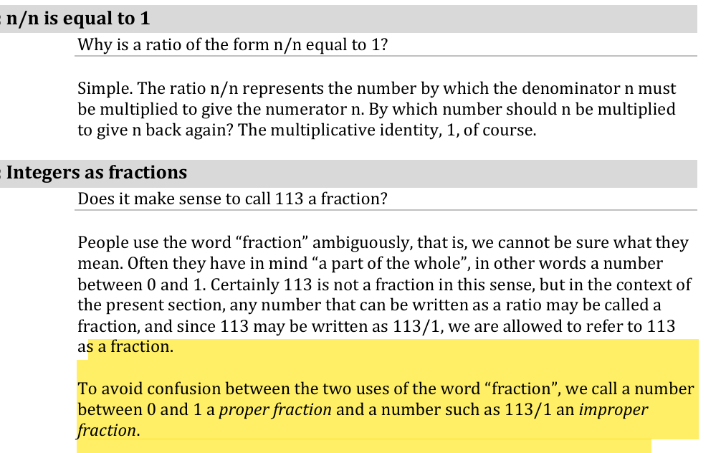
Rationale

Slide 29
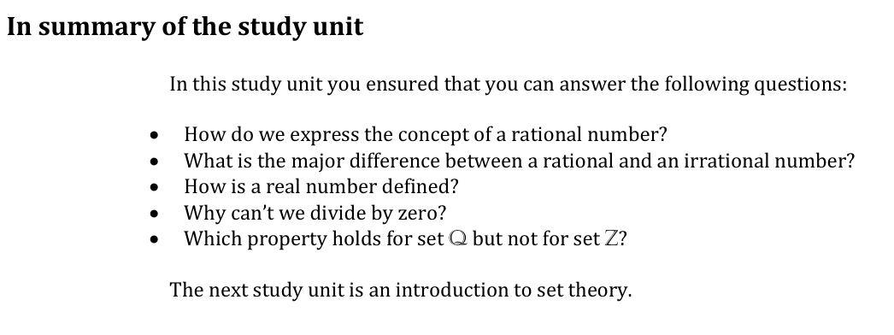
Summary

Slide 30
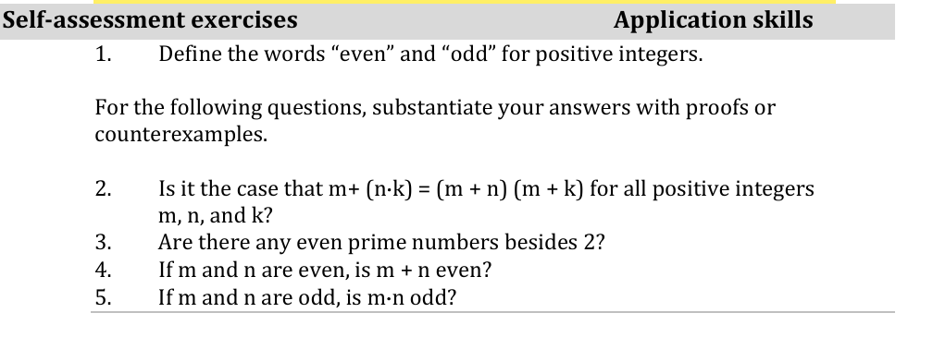
Self-assessment

